Slide 1

NDMA CUAS Specialist Course
System Fault Diagnosis

Slide 2

System Fault Diagnosis – Utilities Folder
Desktop has a Utilities folder. This includes the following programs:
Radar UI – Tool enabling direct connection to the Echodyne Radars.
Useful in the event of possible issues or failures through the Chess CMS system
Note: CMS would need to be closed to allow connection
StartSystem – Diag – Starts the CMS system with Diagnostics enabled.
If issues are experienced that are believed to be CMS related, then the logs are useful to Chess to allow debug to be carried out.
VLC Media Player – Allow the streaming of videos from the TV and TI cameras independent of the VMS.
Note: VMS would need to be closed.
Control Centre – Allow direct communication to the Vector Nav unit
Note: CMS would need to be closed to allow connection

Slide 3
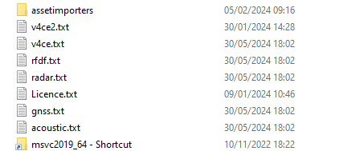
System Fault Diagnosis – CMS Diagnostic Logging
If CMS system issues are experienced, then logfiles maybe required to allow debug to take place by Chess Dynamics.
Process:
Using the shortcut in Utilities, StartSystem – Diags
This will start the CMS and operation will be as normal
Run the CMS until failure occurs
Close CMS using “Stop CMS” on desktop.
Copy the text files shown from the following directory:
C:\Chess-Dynamics\2104-C2\Qt

Slide 4
System Fault Diagnosis – Viewing Video Streams in VLC
If experiencing Video display Issues in the VMS the streams can be viewed in VLC Player.
(Available in Utilities Folder)
Open a new Network Connection (CTRL+N)
  For TV: upd://@239.0.0.1:9001
  For TI: udp://@239.0.0.1:9002
  For LRF: udp://@239.0.0.1:9003
  Note: To be able to display TI video, it would have to be switched on through the VMS.

Slide 5
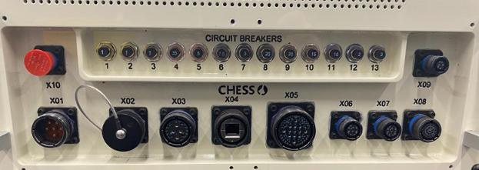
System Fault Diagnosis – RJB Circuit Breakers
CB-1: 1A – Spare
CB-2: 1A – Spare
CB-3: 1A – Internal Logic Supply
CB-4: 35A – Radar Supply
CB-5: 5A – IMU Supply
CB-6: 7.5A – PLT Logic Supply
CB-7: 3A – Laser Supply
CB-8: 20A – PLT Actuator Supply
CB-9: 30A – PLT Payload Supply
CB-10: 15A – Display Supply
CB-11: 15A – GRIP Supply
CB-12: 3A – RJB Fan Power
CB-13: 3A – Switch Box Supply

Slide 6
System Fault Diagnosis
Issue | Possible Causes/Rectification
System Unresponsive | Check Switch box is connected Ensure System switch is activated Check CB's on Rack Junction box Check X01 is connected correctly Check PSU is powered on Check main circuit breakers in distribution Contact Chess Dynamics/Replace Rack Junction Box / Switch Box
No Communications or Picture from TV Camera | Check BIT Status Check all connectors are tightened and undamaged Check CB9 on RJB, reset if needed Check Power to Camera at Connector on 2105-W13 Check/Replace if Camera Contact Chess Dynamics/Replace Payload Junction Box
No Communications or Picture from MWIR | Check BIT Status Check all connectors are tightened and undamaged Check camera has been enabled in VMS Check CB9 on RJB, reset if needed Check Power to Camera at Connector on 2105-W13 Check/Replace if Camera Contact Chess Dynamics/Replace Payload Junction Box
No Return from LRF | Check BIT status Check all connectors are tightened and undamaged Fire LRF Using internal camera to check the target is being hit, readjust Boresight if necessary Check CB-7 has not tripped Contact Chess Dynamics/Replace LRF
Note: Refer to 2169-ICD01 – Electrical Interface Control Document for information on cable pins and cable power

Slide 7
System Fault Diagnosis
Issue | Possible Causes/Rectification
No Video from LRF | Check BIT status Check all connectors are tightened and undamaged Check settings in Boresight screen and ensure option is selected (Shift X) Contact Chess Dynamics/Replace LRF
No Communications to Radar | Check BIT Status of Radars Ensure Radars are switched on at Switch Box Check all connectors are tight and undamaged Check CB-4 has not tripped. Check Power output from RJB Check power on 2169-W17 Cable Contact Chess Dynamics/Replace Radar Panel
EOD Fails to move in one axis | Check the system is not jammed by foreign object Contact Chess Dynamics/Replace EOD
EOD Fails to move | Check the system is not jammed by foreign object. Check CB-8 has not tripped Check Cables are tightened and undamaged Check 48Vdc actuator power on 2169-W15 Check if system will move to manual mode (press brakes and move) Contact Chess Dynamics/Replace EOD
Note: Refer to 2169-ICD01 – Electrical Interface Control Document for information on cable pins and cable power

Slide 8
System Fault Diagnosis
Issue | Possible Causes/Rectification
No Communication to EOD or EOD Unresponsive | Check System power is on Check all cables are tightened and undamaged Check 24Vdc Power to EOD on 2169-W15 Check CB-6 and CB-8 have not tripped Contact Chess Dynamics/Replace EOD
Poor Optical Alignment | 1. Re-check alignment with procedures in the maintenance manual
Note: Refer to 2169-ICD01 – Electrical Interface Control Document for information on cable pins and cable power

Slide 9
Routine Maintenance
Questions?

